Slide 1
COVID-19
Faculty & Staff Education
Department of Anesthesiology
*As of March 26, 2020

Slide 2
Disclaimer
The state of COVID-19 is rapidly evolving. Data presented will change with time.

Slide 3
Objectives
Epidemiology
Virology
Clinical features
Special populations
Personal protective equipment
Mitigation strategies
Investigational drugs and vaccines
Where you can learn more

Slide 4
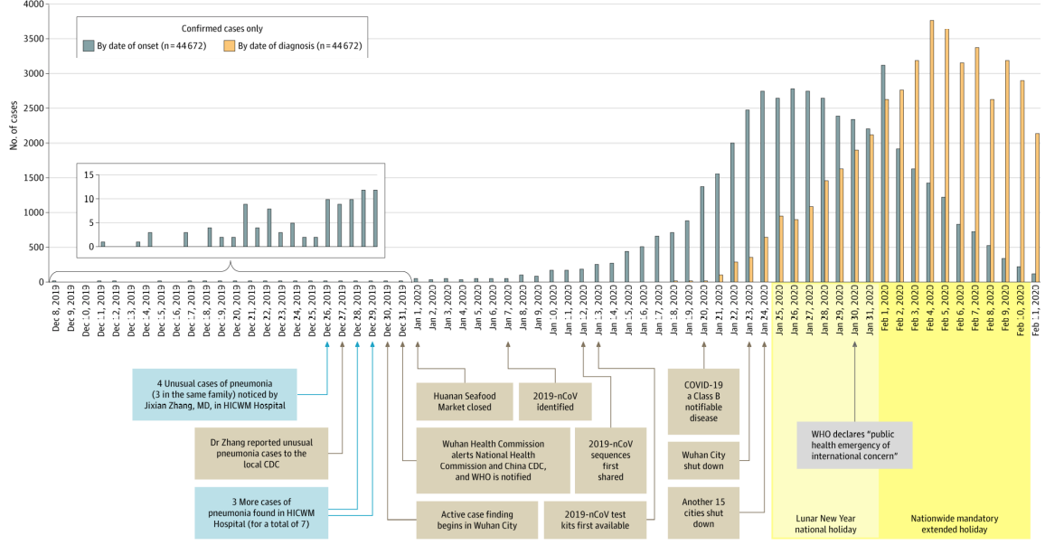
Wu Z, McGoogan J. JAMA. Pub February 24, 2020. doi:10.1001/jama.2020.2648
Early Events

Slide 5
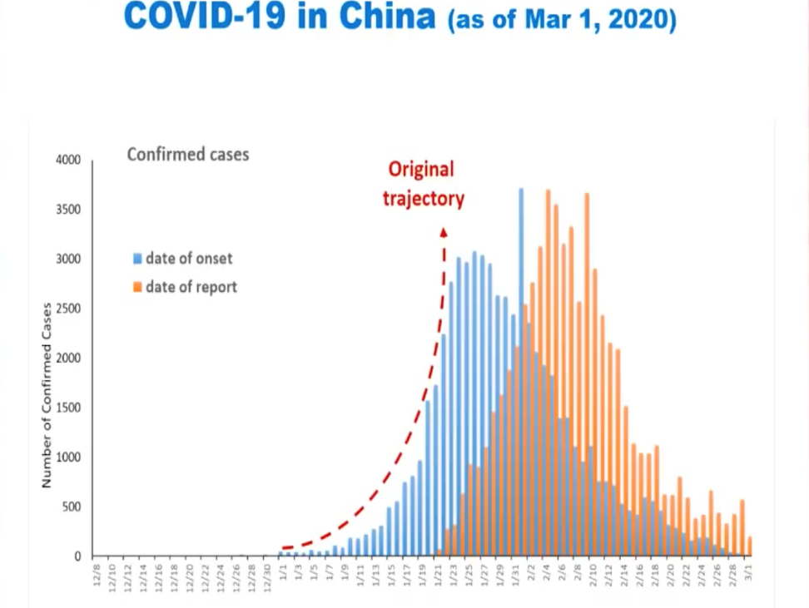
Source: CROI Meeting, https://special.croi.capitalreach.com

Slide 6
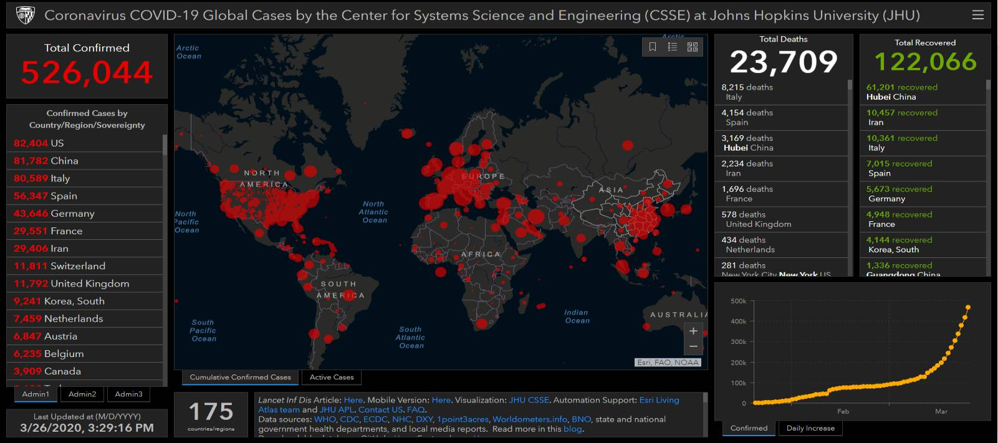
*As of March 26, 2020
https://coronavirus.jhu.edu/map.html

Slide 7
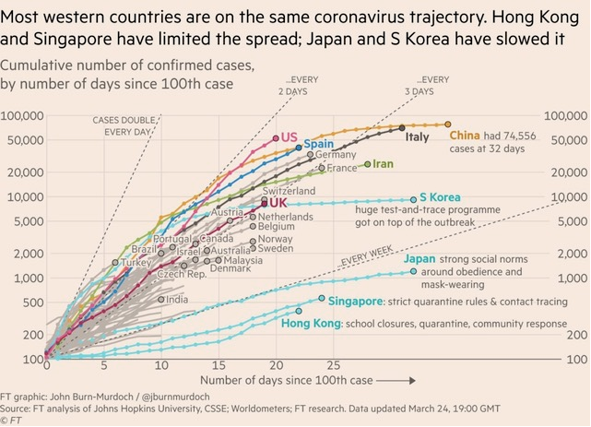
COVID-19 Epidemic Curves by Countries
Downloaded 3/25/20 from Financial Times https://www.ft.com/coronavirus-latest

Slide 8
COVID-19 Now a Pandemic
Pandemic = global outbreak of disease
New pathogen emerges, infects people and spreads between people sustainably
Worldwide spread occurs due to lack of pre-existing immunity
Cases in most countries worldwide; community spread in a growing number of countries
March 11, the COVID-19 declared a pandemic by the WHO
Rapidly evolving situation and new approaches are emerging
Source: https://www.cdc.gov/coronavirus/2019-ncov/cases-updates/summary.html?CDC_AA_refVal=https%3A%2F%2Fwww.cdc.gov%2Fcoronavirus%2F2019-ncov%2Fsummary.html

Slide 9
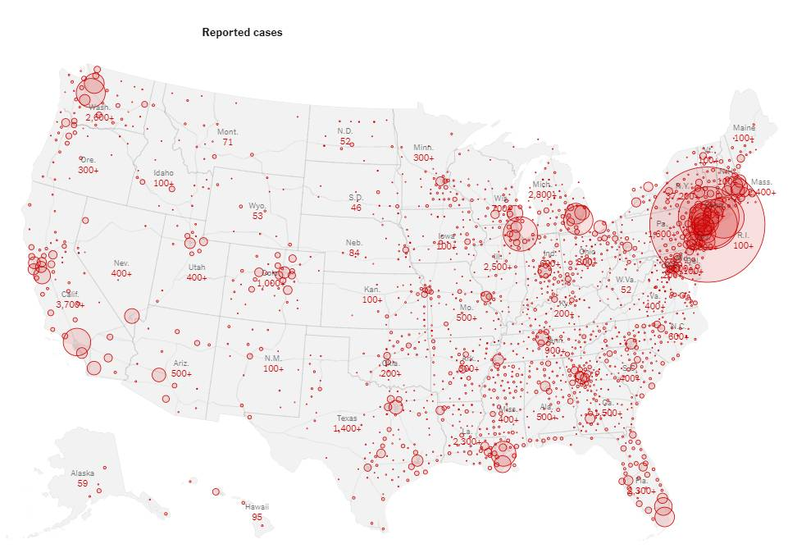
Number of Reported COVID-19 Cases in the US
*As of March 25, 2020 6AM
https://www.nytimes.com/interactive/2020/world/coronavirus-maps.html

Slide 10
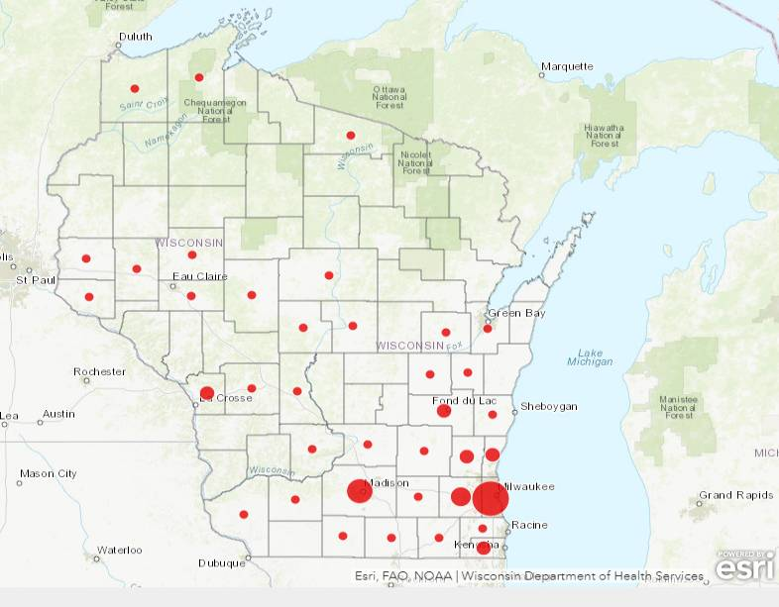
COVID-19 in Wisconsin

Slide 11
Source: CROI Meeting, https://special.croi.capitalreach.com

Slide 12
Source: CROI Meeting, https://special.croi.capitalreach.com

Slide 14
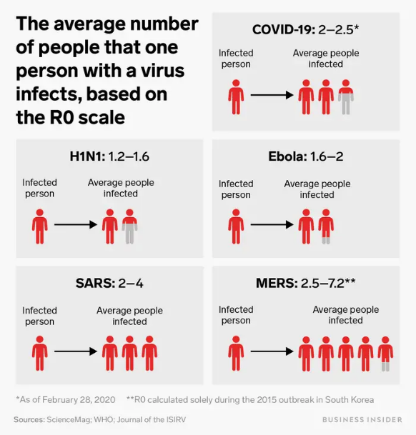
https://www.businessinsider.com/coronavirus-contagious-r-naught-average-patient-spread-2020-3
Notes:
<number>

Slide 15
Alywalrd B et al, WHO-China Mission, 2020
lSource: CROI Meeting, https://special.croi.capitalreach.com

Slide 16
Source: CROI Meeting, https://special.croi.capitalreach.com

Slide 18
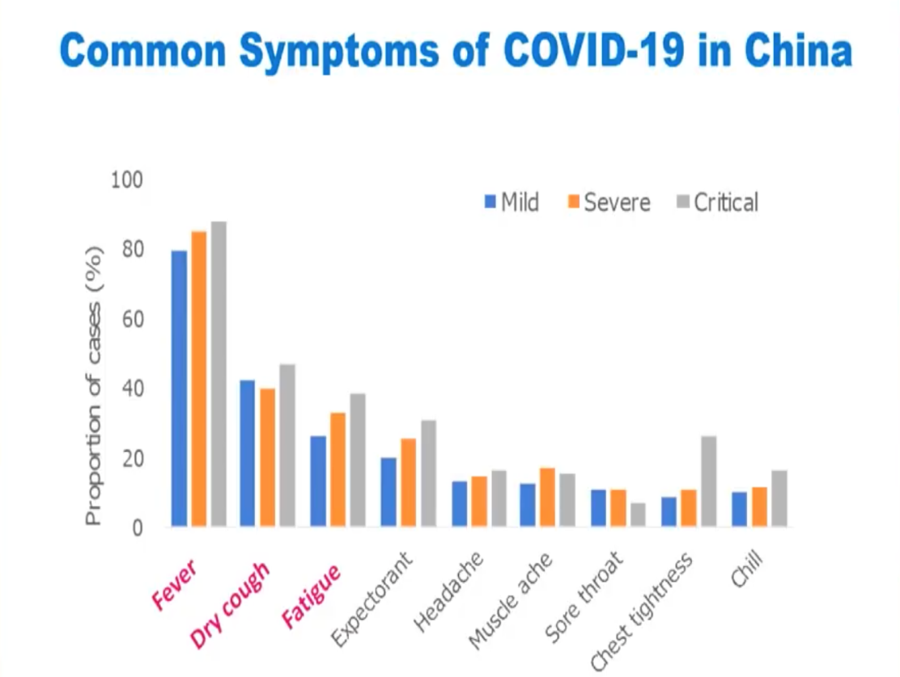
Source: CROI Meeting, https://special.croi.capitalreach.com

Slide 19
Clinical Manifestations 1099 Hospitalized Patients
Symptoms
Fever 89%, cough 68%, sputum production 34%, sore throat 14%, nasal congestion 5%, diarrhea 4%
Fever (on admission – 44%)
Incubation period 4 days (IQR 2-7 days)
Laboratory studies
Lymphopenia (83%), CRP>10mg/l 61%, procalcitonin >0.5 ng/ml 6%, LDH >250 U/l 41%, ALT/AST >40 U/l 22%
Radiology
Ground glass opacities (56%), 18% no abnormalities in non severe disease
Guan W NEJM 28Feb20

Slide 20
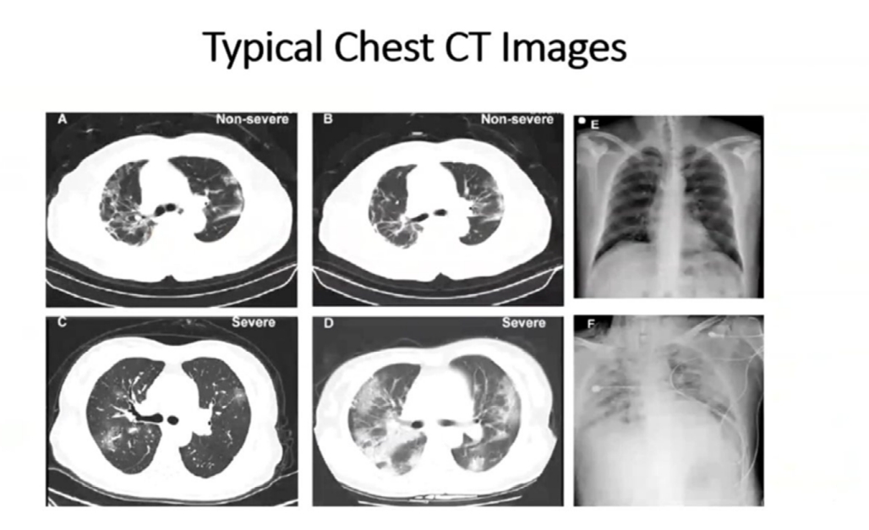

Slide 21
Clinical Course/Spectrum of Illness
Incubation period: 5-6 days
Time to recovery: mild -> 2 weeks, severe -> 3-6 weeks
>14% develop severe disease
5% require ICU level care
2% mechanical ventilation
1-3% estimated case fatality rate
Complications
Pneumonia, ARDS, sepsis, AKI, cardiac dysfunction
Highest risk
>60, comorbidities, higher SOFA score, D-dimer >1 ug/l
Children have milder disease
Munster V NEJM 20Feb20
Zhou F Lancet 9Mar20
Alywalrd B, WHO-China Mission, 2020

Slide 22
Phases of Illness
Prodrome: Non-specific LRI with poor oral intake
Smoldering hypoxemia often with less dyspnea than SaO₂ might suggest
Overt resp distress with increasing FIO₂ (6+ liters PNC),increased WOB, anxiety and subjective dyspnea now prominent
Respiratory Collapse: Early controlled intubation important
Difficulty with secretions
CRP and D-Dimer elevation; Low procalcitonin and nl WBC
MSOF with AKI, myocarditis encephalopathy or resolution

Slide 24
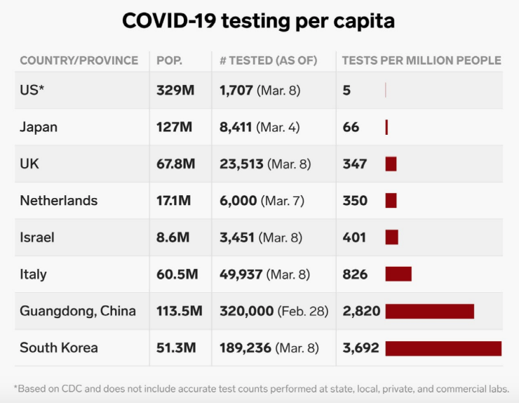
Testing Capacity: a major challenge
https://www.businessinsider.com/coronavirus-testing-covid-19-tests-per-capita-chart-us-behind-2020-3

Slide 25
Source: CROI Meeting, https://special.croi.capitalreach.com

Slide 26
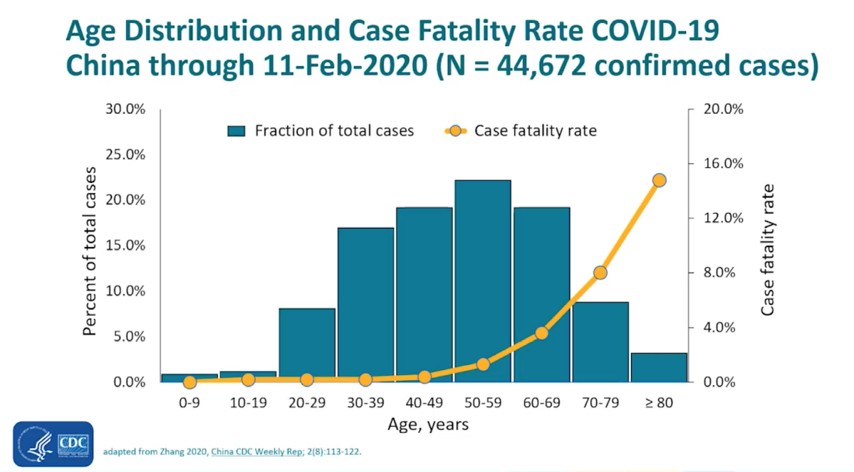
Source: CROI Meeting, https://special.croi.capitalreach.com

Slide 27
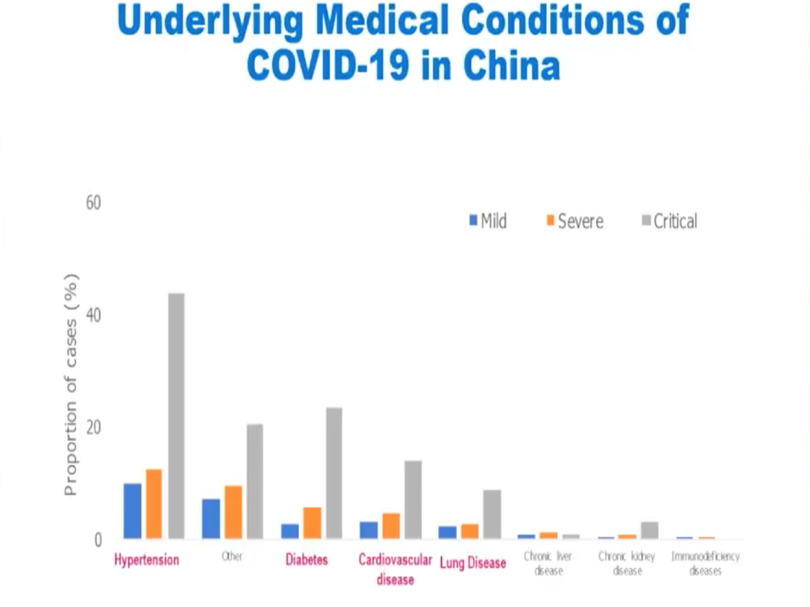
Source: CROI Meeting, https://special.croi.capitalreach.com

Slide 28
Source: CROI Meeting, https://special.croi.capitalreach.com

Slide 29
Source: MGH Grand Rounds 12 Mar 20

Slide 30
Source: CROI Meeting, https://special.croi.capitalreach.com

Slide 31
Source: CROI Meeting, https://special.croi.capitalreach.com

Slide 32
How long does virus survive on surfaces?
Stability of SAR-CoV-2 similar to SARS-CoV-1
Aerosols: hours
Surfaces: days
Dependent on inoculum shed
SARS-CoV-2
SARS-CoV-1
Van Dermalen N NEJM 17Mar20
Notes:
<number>

Slide 33
Source: CROI Meeting, https://special.croi.capitalreach.com

Slide 35
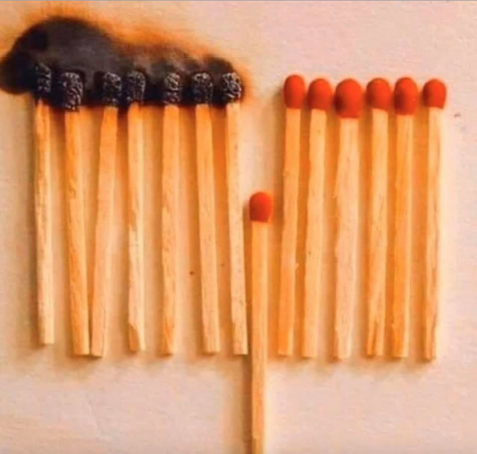
How social distancing disrupts spread

Slide 36
Impact of Social Distancing-Historical Data

Slide 37
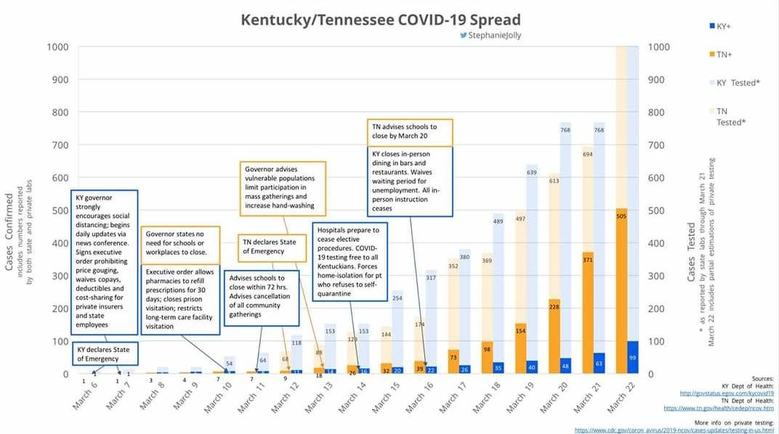
Impact of Social Distancing-Early COVID-19 Data

Slide 38
NPI: Personal Action
Everyone can do their part to help us respond to this emerging public health threat
Take care of yourself and follow recommended infection control procedures
After household spread, health care associated infections will be a main driver of new infections. If you are a healthcare provider, report any new signs of respiratory track infection to your supervisor and to Occupational health before reporting to work so you can be evaluated for testing for SARS COV-2
General preventative measures:
Hand washing with soap and water for at least 20 seconds
Avoiding touching your eyes, nose and mouth with unwashed hands
Stay home when sick!
Source:https://www.cdc.gov/coronavirus/2019-ncov/cases-updates/summary.html?CDC_AA_refVal=https%3A%2F%2Fwww.cdc.gov%2Fcoronavirus%2F2019-ncov%2Fsummary.html

Slide 39
PPE and Anesthesiologist/CRNA
Your leadership is actively engaged in improving access to PPE
We need to make sure whether in the OR in response to acute respiratory decompensation that intubation occurs in the most controlled way possible
We must be diligent in assuring that we follow emerging data on how to best mitigate the risk to high-risk professions like yours

Slide 40
Notes:
<number>

Slide 41
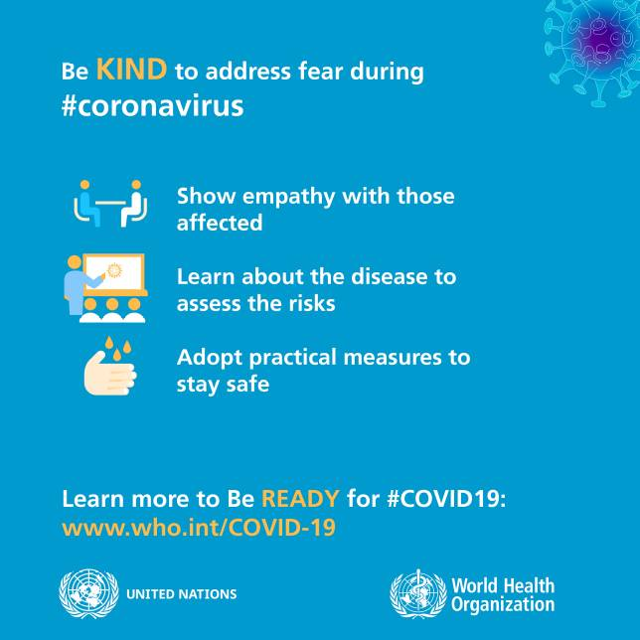
Notes:
<number>

Slide 42
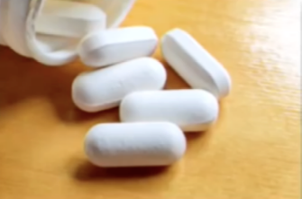
Treatment: no specific antiviral available
Supportive care
Ventilator considerations
Concomitant infections (bacterial, viral, fungal)
Corticosteroids, IL- 6/8 (tocilizumab)
Off the shelf/repurposed agents
Lopinavir/ritonavir, chloroquine, penciclovir, ribavirin
ARBs/ACE inhibitors
Experimental medications
Favipiravir (T-705), remdesivir
monoclonal antibodies

Slide 43
Source: CROI Meeting, https://special.croi.capitalreach.com

Slide 44
Source: CROI Meeting, https://special.croi.capitalreach.com

Slide 45
Resources
Infoscope https://infoscope.mcw.edu/Coronavirus/COVID-19-FAQs.htm
Scout https://intranet.froedtert.com
MCW Library https://mcw.libguides.com/coronavirus
Center for Disease Control and Prevention https://www.cdc.gov/coronavirus/2019-ncov/index.html
Wisconsin Department of Health https://www.dhs.wisconsin.gov/covid-19/index.htm
BWH Clinical Protocols: https://www.covidprotocols.org/
Center for Infectious Disease Research and Policy http://www.cidrap.umn.edu/covid-19

Slide 46
Questions

